Slide 1



NO LIMIT LIVING
X
DATA MINE
12/4/2024
© 2024 NO LIMIT LIVING, LLC. ALL RIGHTS RESERVED.

Slide 2

CONTENT
01
Introduction
02
Fall 2024
03
Demo
04
Spring 2025
05
Conclusion
06
Acknowledgements

Slide 3
Dataset link
https://hub.mph.in.gov/dataset/indiana-arrest-data

Slide 4
01 - Introduction
Company’s Background
No Limit Living, LLC is a real estate investment firm that focuses on acquiring, rehabilitating, renting, and selling residential properties.

Slide 5
Problem Statement
This project aims to analyze historical crime data to identify trends and develop a predictive model that forecasts crime rates for the coming years. By providing insights into future crime patterns, the model supports law enforcement, policymakers, and potential investors in making informed decisions, allowing for strategic resource allocation, planning for crime prevention, and assessing areas for safer investment.

Slide 6
Project Goal
The goal of this project is to build a predictive model that analyzes historical crime data to forecast future crime rates

Slide 7
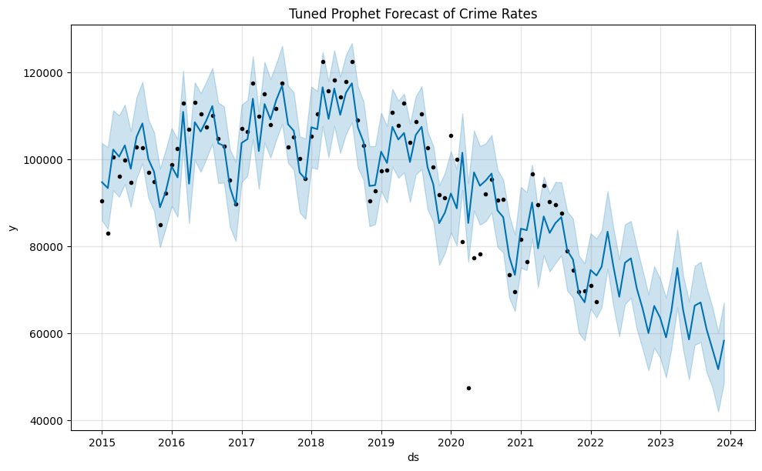
Plot the forecasted data

Slide 8

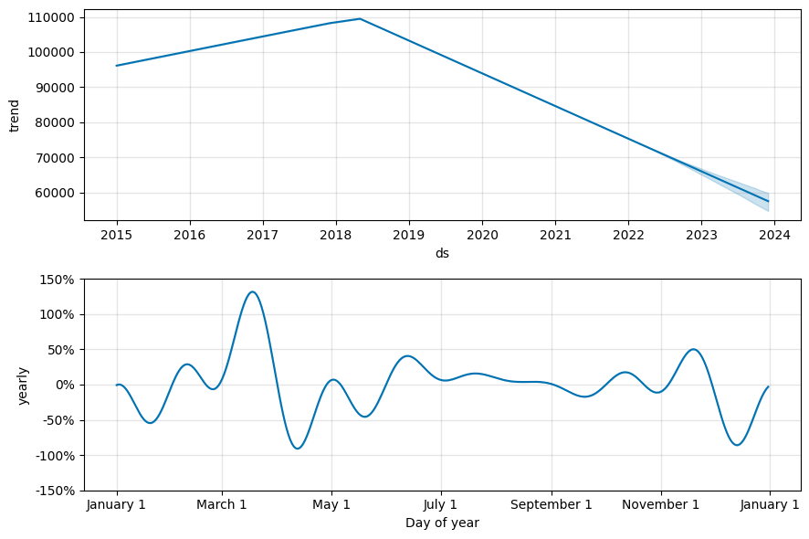
Plot the components of the forecast (trend, yearly seasonality)
© 2024 NO LIMIT LIVING, LLC. ALL RIGHTS RESERVED.

Slide 9
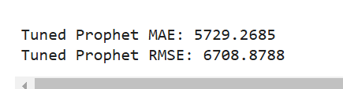
Calculating MAE and RMSE for tuned Prophet model

Slide 10
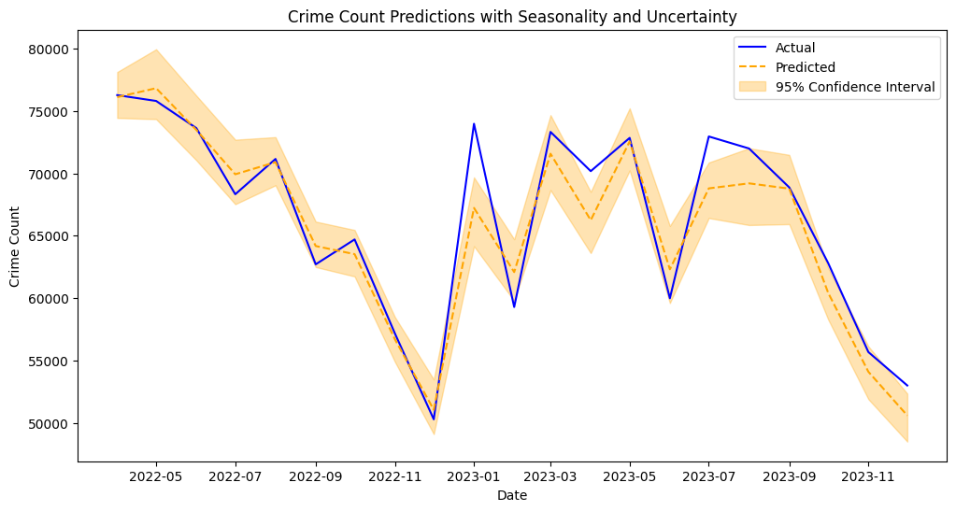
Plot actual vs predicted with uncertainty

Slide 11
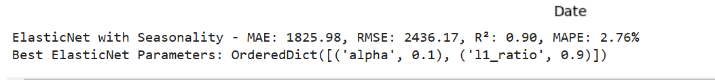

Slide 12
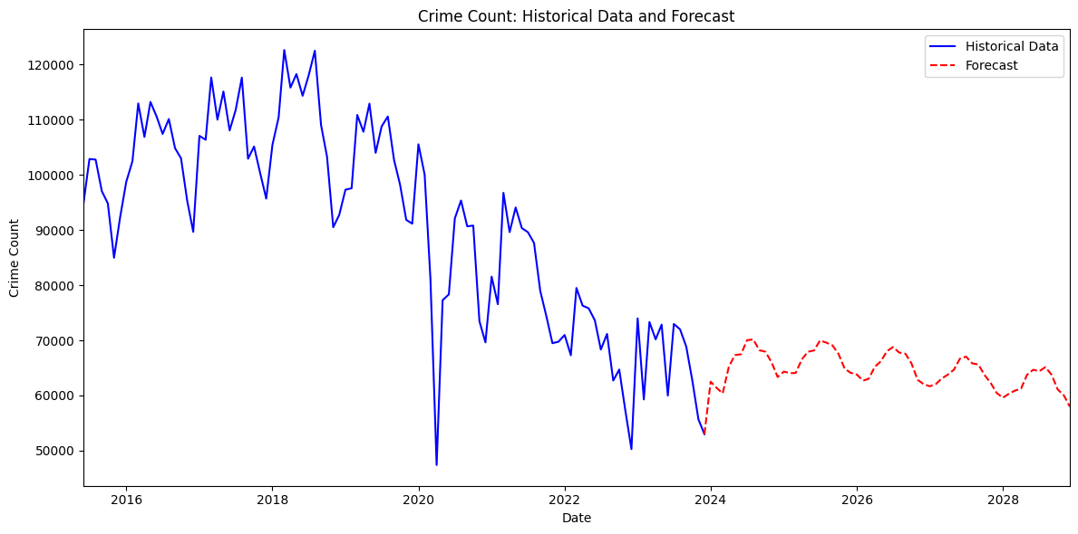

Slide 13
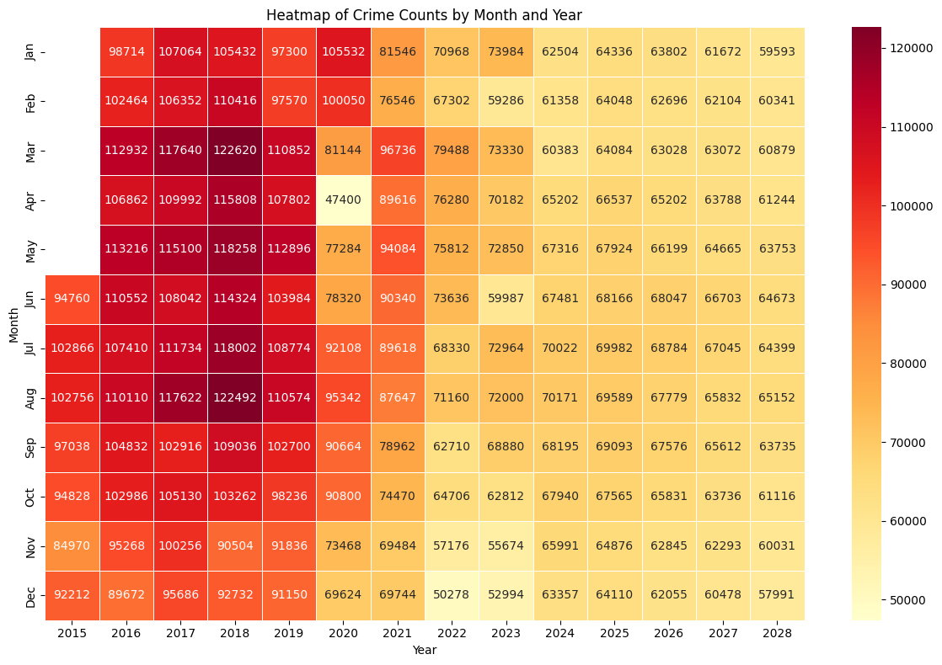
Heatmap of Crime Counts by Month and Year
© 2024 NO LIMIT LIVING, LLC. ALL RIGHTS RESERVED.
Notes:
Frontend

Slide 14
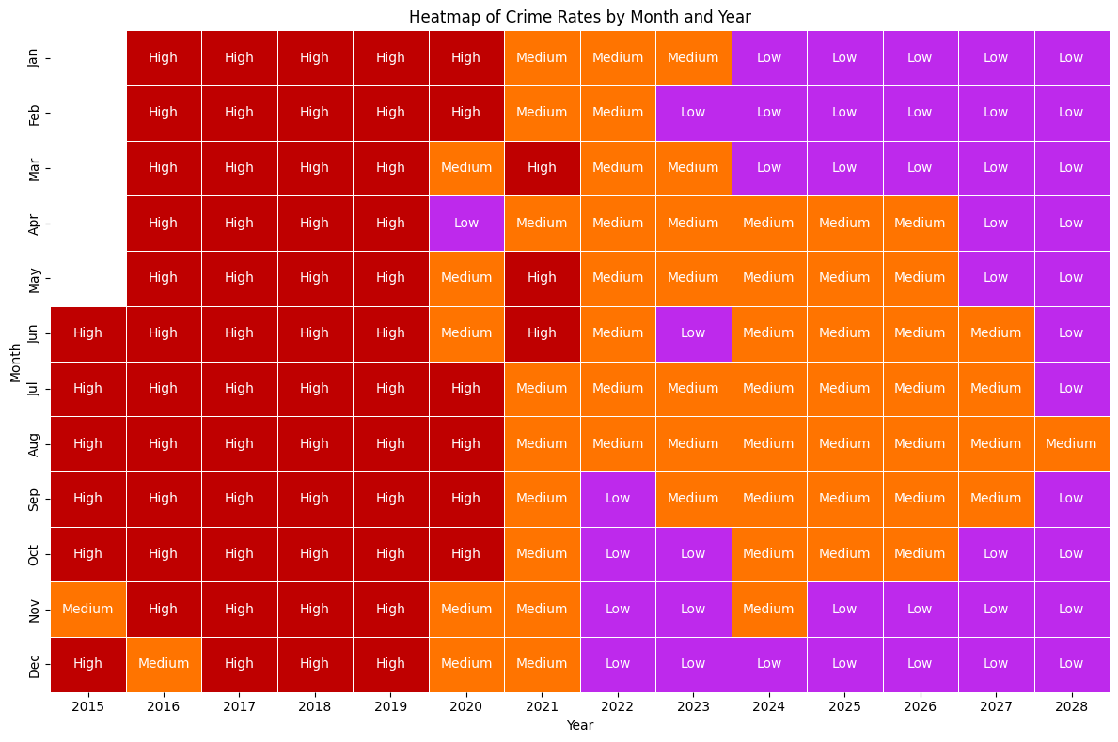
Heatmap of Crime Rates by Month and Year
© 2024 NO LIMIT LIVING, LLC. ALL RIGHTS RESERVED.
Notes:
Frontend

Slide 15
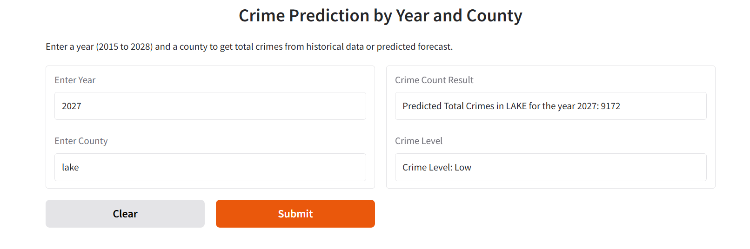
RESULTS
© 2024 NO LIMIT LIVING, LLC. ALL RIGHTS RESERVED.
Notes:
Frontend

Slide 16
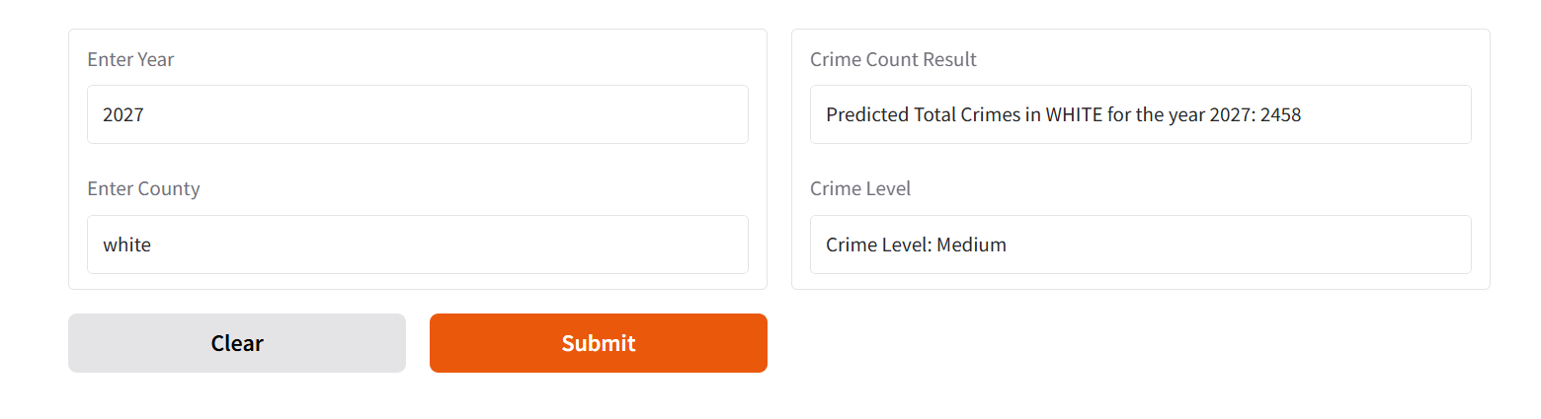
RESULTS
© 2024 NO LIMIT LIVING, LLC. ALL RIGHTS RESERVED.
Notes:
Backend

Slide 17
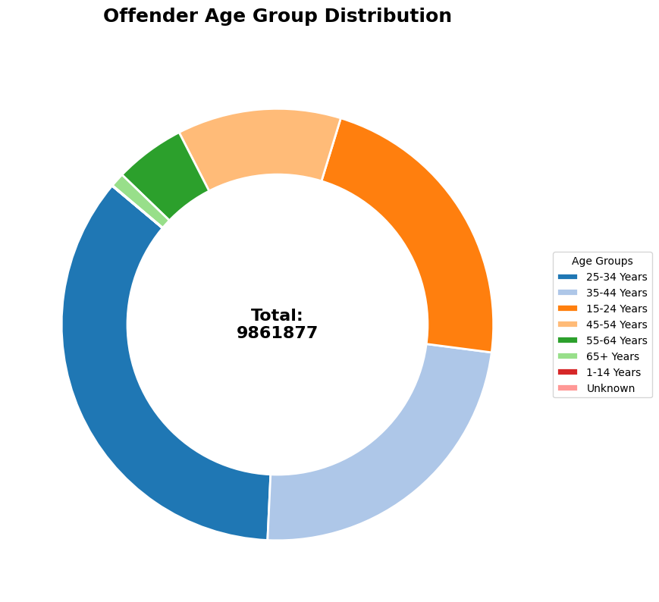
counts of each offender age group
© 2024 NO LIMIT LIVING, LLC. ALL RIGHTS RESERVED.
Notes:
Backend

Slide 18
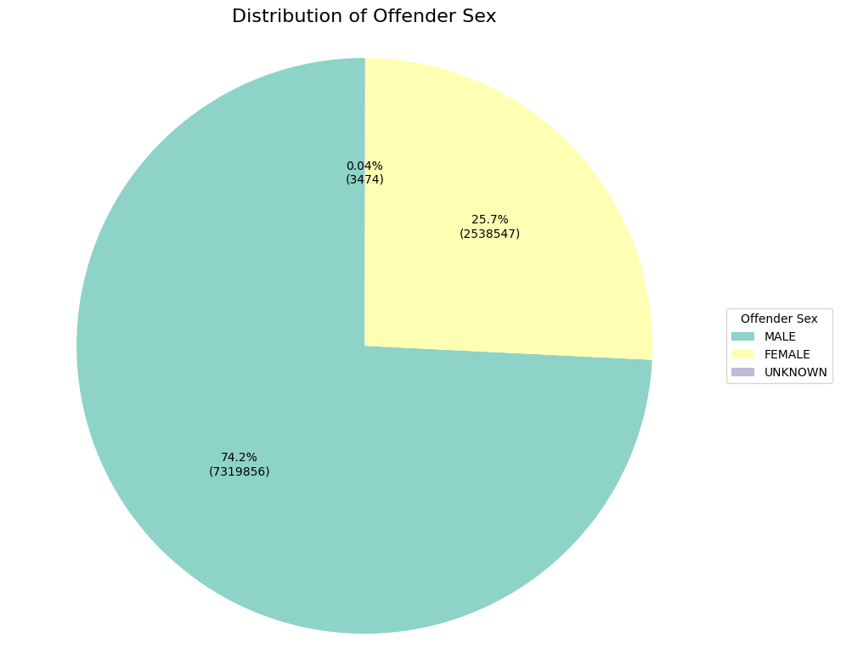
© 2024 NO LIMIT LIVING, LLC. ALL RIGHTS RESERVED.
Notes:
Backend

Slide 19
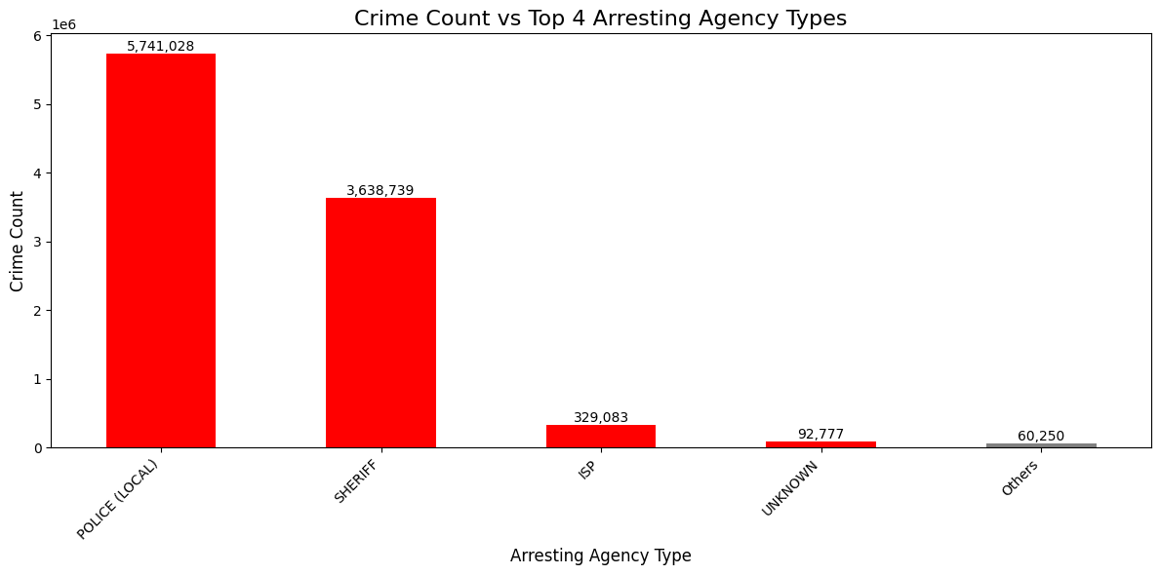
© 2024 NO LIMIT LIVING, LLC. ALL RIGHTS RESERVED.

Slide 20
06 - Acknowledgements and Thanks
Emmani Ellis
Sharan Sivakumar
Thanmaya Pattanashetty
Nicholas Lenfestey
Abhinav Chowdary

Slide 21
References
Python Tutorial :https://www.youtube.com/watch?v=7wnove7K-ZQ&list=PLu0W_9lII9agwh1XjRt242xIpHhPT2llg
Machine learning :https://www.youtube.com/watch?v=_u-PaJCpwiU&list=PLu0W_9lII9ai6fAMHp-acBmJONT7Y4BSG

Slide 22

THANK YOU!
Company Socials:
Instagram - @nolimitliving_
LinkedIn - No Limit Living
Facebook - No Limit Living
Twitter - @nolimitliving_
eellis@nolimitlivingllc.com
© 2024 NO LIMIT LIVING, LLC. ALL RIGHTS RESERVED.

